Slide 1


SMART INDIA HACKATHON 2025
TECH TITANS 1
Problem Statement ID : SIH25131
Problem Statement Title : A website that predicts the most probable disease a patient have and connect them to doctors online.
Theme: Student Innovation
PS Category : Software
Team ID:
Team Name: Tech Titans 1

Slide 2
Proposed Solution
Develop an AI-powered website where patients can input their symptoms.
AI Model analyzes the symptoms and predicts the most probable diseases with confidence percentage.
Suggests the right specialist doctor (e.g., cardiologist, dermatologist, neurologist).
Provides multiple consultation options:
Text chat with doctor
Video call consultation
Appointment booking (online/offline)
Patient Dashboard to track:
Medical history
Medicine schedules
Reports & precautions
Doctor Portal: Doctors can log in, view patient details, and give e-prescriptions.
Nearby Doctor Search for emergency or physical consultations.
Secure login & data privacy using encrypted storage.
Accessible for both urban & rural users with multilingual and voice input support.

Slide 3
Technology Stack
🔹 Frontend
HTML, CSS, Java, React
🔹 AI Model
Python
Random Forest (Rainforest model in your file → probably Random Forest)
Python libraries (scikit-learn, pandas, numpy, etc.)
🔹 Backend
Python & its libraries (Flask/Django for server, MySQL for database)

Slide 4
Feasibility and Challenges
Feasibility
Challenges
Technical Feasibility
Proven AI/ML models (Random Forest, Neural Networks) can predict diseases from symptoms.
Operational Feasibility
24/7 availability with minimal staff once AI is trained.
Accuracy of Prediction
AI may not always be 100% accurate → Need constant training with verified medical datasets.
Digital Divide
Rural/elderly populations may face issues using the platform → Need for multilingual and voice-based input.

Slide 5
Impacts and Use Cases
Impacts
Use Cases
Reduces burden on hospitals by filtering non-critical cases.
Promotes digital healthcare adoption in India.
Enhances data-driven healthcare research (AI learns from patterns in patient data).
Can serve as a national health database for better policymaking.
A patient with cough & fever → AI suggests flu or COVID → Connects to physician.
A person with chest pain → AI suggests possible heart disease → Emergency alert + cardiologist referral.
Student in rural village → Online consultation with dermatologist for skin disease.

Slide 6
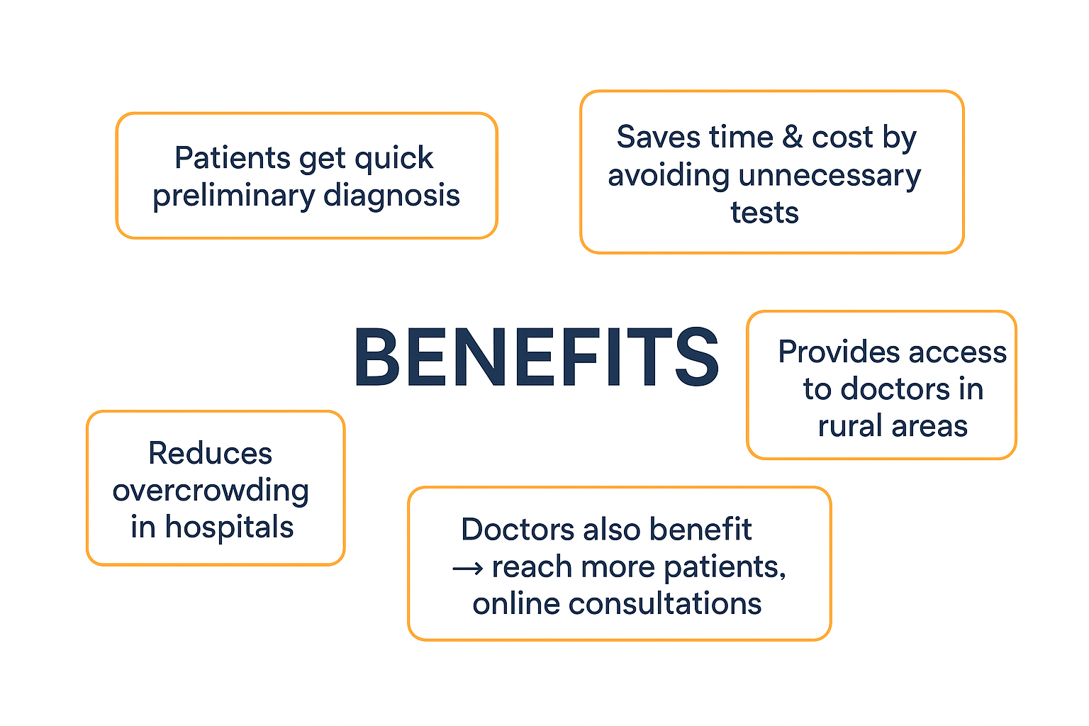

Slide 7
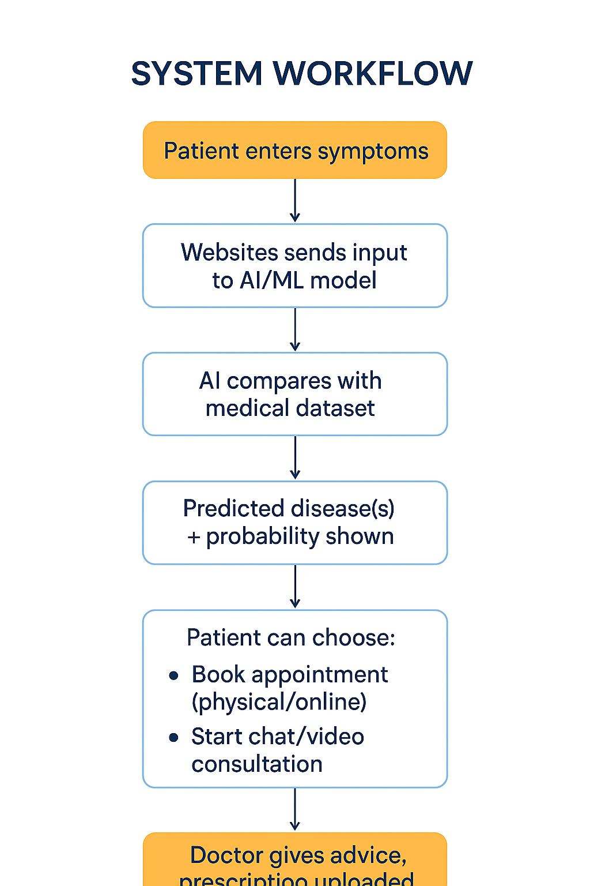
Technical Approach

Slide 8
Reference:
THANK YOU

